Slide 1

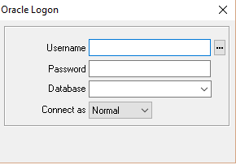

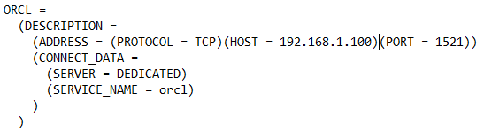

Client
Shared Pool
Buffer Cache
Log Buffer
……
Before image
SCOTT
Update …
Update …
Memory
Instance
Commit;
ORCL
After image
Parse
Execute
SERVER
PMON
SMON
DBWn
USER
CKPT
LGWR
OK
OK
10
10
Update…
Commit;
11
11
10
11
12
11
10
10
SQL> Update …
Physical
11
Datafiles
SQL> Commit;
Redo log file
Control file
Before image
Switch
DATABASE
X
Image
Overwriten
Logical
Table
UNDO
TABLESPACES
Notes:
https://www.youtube.com/watch?v=wDZWVRvhgoc
Let's start first with the database structure. On the left side, you have the client here. On the right side, you have the server here. The server'side is divided in 3 main structures: the memory, the logical structure and the physical structure.To provide you every steps of transaction, we would be using user Scott. It is important to know that the whole string is an alias and other database names. the string will be compared to this alias inside of a … This is similar to DNS will obtain all the nescessary details to read the database server. Locally, a user's process will be allocated and validated to connection through with listeners. The listeners will be interested to allocate to server's process. The user's processes is now linked to server's process. … For this example, we will execute an update. First, this s … will be validated, we call this step "the parsing". The server's process sends back the confirmation of the parsing. The statement will then be written into the shared pool and the redo log buffer. Next, we will also be created into the shared pool. The database lock, that is used for the transation, will be read and copied into the database Buffer cache. Only the field implicated in this transaction will be held into a none-do segment till the transaction is completed. We call those copies "the Before Image". A copy of this block will be duplicated with the update … .This copy is called "the after image". A confirmation will be sent to the user's process. The commit statement completes the transaction and is written into the redo log buffer. The commit statement triggers the log like a process and will send all statement for the current consation into the redo log files. The before image in the undo segment could be then deleted when the … of the undo retention primary switch. a last confirmation will be sent to the user's process. When the correct log's full, it generates switch log, triggering at the same time the ARCn's process and the log sequence number. The ARCn will generate and the …. With the contact of the current log.A switch log will then trigger, its checkpoint passes, that will … (không nghe được động từ gì) checkpoint number by applying this last number into each data … (khoong nghe ). The checkpoint process'll finally trigger the database right the process and right the last image from the database … into the table

